Slide 1


Ebuka Bertrand Osunwoke
07-10-2022

Slide 2

Outline
Executive Summary
Introduction
Methodology
Results
Conclusion
Appendix

Slide 3
Executive Summary
SpaceY wants to compete in the rocket launch market with SpaceX We will collect, clean, manipulate and use the data to predict the success of failure of SpaceX falcon 9 rocket launch. The success of a rocket launch depends on certain factors which will be investigated and discovered in this study. This information will help Space Y compete and launch rockets cheaper.

Slide 4
Introduction
SpaceX claims that it can successfully launch falcon 9 rockets into space at just 20-30% the cost of rocket launch. They claim this is possible because they are able to reuse most of the first stage materials. The success or failure is investigated using data science methodologies and the preconditions that contribute to the successful launch and landing if Falcon9 are discovered. This information can help SpaceY compete in the rocket launch industry.

Slide 5

Section 1

Slide 6
Methodology
Executive Summary
Data collection methodology:
Describe how data was collected
Perform data wrangling
Describe how data was processed
Perform exploratory data analysis (EDA) using visualization and SQL
Perform interactive visual analytics using Folium and Plotly Dash
Perform predictive analysis using classification models
How to build, tune, evaluate classification models

Slide 7
Data Collection
The data was collected using two methods.
API calls and get requests were used to collect the data from the SpaceX api. The collected data was represented in a dataframe using ‘pd.json.normalize’
Webscrapping was used to collect the data. Functions were extract certain specific information from the scraped data.
These methods are described in the next few slides

Slide 8
Data Collection – SpaceX API
1
2
Pass get request to SpaceX api using reguests.get(“url”),
3
Use the functions to collect the needed data from the requested data
Create functions for collecting and storing important columns
5
4
Store all collected lists into a dictionary
Convert the dictionary into a dataframe.
Use pd.json_normalize to format the requested data.
Notes:
Github url of completed notebook: https://github.com/BlacPharaoh/data-science-project-/blob/main/IBM%20DS%20capstone%20project.%20data%20collection_wrangling.ipynb

Slide 9
Data Collection - Scraping
1
2
Get a response from SpaceX api using reguests.get(“url”),
3
Use the functions to collect the needed data from the html tables (soup object)
Create functions for collecting and storing important columns
5
4
Store all collected lists into a dictionary
Convert the dictionary into a dataframe.
Create a soup object from the response using beautiful soup
Notes:
Github url: https://github.com/BlacPharaoh/data-science-project-/blob/main/Data%20collection%20using%20webscraping.ipynb

Slide 10
Data Wrangling
After collecting the data using the REST api, the collected data was filtered to include only information of falcon9 rockets.
Missing values were identified in the LandingPad and PayloadMass columns using ‘pd.isnull()’
The missing values in the payload mass were replaced by the average payload mass using the function; ‘np.replace()’
1
Identify missing values in the dataframe using pd.isnull()
2
3
Replace missing/null values by average value in the columns
Missing values were identified in the PayloadMass and LandingPad columns
Notes:
Data Wrangling: https://github.com/BlacPharaoh/data-science-project-/blob/main/IBM%20DS%20capstone%20project.%20data%20collection_wrangling.ipynb

Slide 11
EDA with Data Visualization
Summarize what charts were plotted and why you used those charts
To explore the collected Falcon 9 dataset, the following visualizations were created
Flight number vs payload mass; to observe the relationship between the payload mass and flight number.
Flight number vs Launch site; different launch sites have different success and failure rates.
Payload mass Vs Launch site; to identify the launch sites that carry are predominantly used for heavier rockets
Success rate vs orbit type: to determine orbits with higher success rates.
Flight number and orbit type
Payload and orbit type: which orbits often land heavier rockets
Launch success yearly trend; to observe the trends of falcon 9 launches from previous years.
Notes:
Github URL: https://github.com/BlacPharaoh/data-science-project-/blob/main/jupyter-labs-eda-dataviz.ipynb

Slide 12
EDA with SQL
The following Queries were performed:
Selecting the unique launch sites and displaying records of launch sites CCAFS LC-40, CCAFS SLC-40.
Displayed the total mass carried by NASA (CRS) and the average mass carried by booster version F9 v1.1
Displayed the date when the first successful landing occurred
Displayed the booster versions that carried between 4000-6000 kg payload mass and successfully landed on drone ships
Returned the total number of successful and failed mission outcomes
Returned the booster versions that have carried the maximum payload mass. This was done using subquery
Listed the failed landing outcome in drone ships launched in 2015, and their booster version.
Returned the rank of the landing outcomes between the date 2010-06-04 and 2017-03-20, in descending order

Slide 13
Build an Interactive Map with Folium
The following objects were added to the map; Map Markersfolium.circle, MarkerClusters, MousePosition, polyline, etc.
The circle object was used to identify Launch sites in the map
Marker clusters and marker color were used to cluster successful and failed launch sites
MousePosition was used to get coordinates on the map
Polyline was used to draw lines and calculate distances between the map objects (launch sites and nearby railways, highways, etc)
Link to script can be found here
Notes:
Github Url : https://github.com/BlacPharaoh/data-science-project-/blob/main/lab_jupyter_launch_site_location.ipynb

Slide 14
Build a Dashboard with Plotly Dash
An interactive dashboard was built with Plotly dash
A pie chart was plotted to show the total launches from certain sites
Scatter graph was used to show the relationship between outcome and payload mass (kg) for different booster versions

Slide 15
Predictive Analysis (Classification)
The data was loaded into the notebook using the pandas pd.read function
The data was transformed using standardization and the numpy library.
Next we split the dataset into the training and test sets.
Different ML models were built and tuned using GridsearchCV to find the best hyper-parameters for each model.
The accuracy metrics were used to test our model’s performance. The performance of our models could be improved by feature engineering.
the best classifier was selected.
Link to script is attached here
Notes:
Link to github notebook: https://github.com/BlacPharaoh/data-science-project-/blob/main/SpaceX_Machine%20Learning%20Prediction_Part_5(1).ipynb

Slide 16
Predictive analysis: Process flow
Load clean data using pandas pd.read function
Transform data using standardization and the numpy library.
The accuracy metrics were used to test our model’s performance.
split the dataset into the training and test sets.
Different ML models were built and tuned using Gridsearch CV
Select the best classifier

Slide 17
Results
Exploratory data analysis results
Interactive analytics demo in screenshots
Predictive analysis results

Slide 18

Section 2

Slide 19
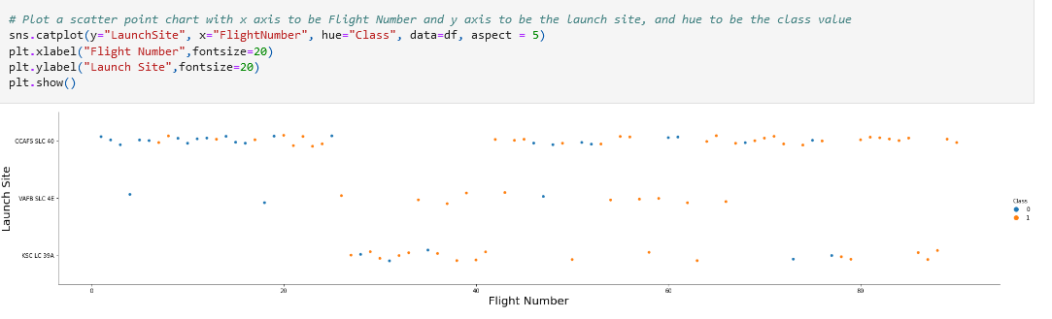
Flight Number vs. Launch Site
From the plot above. the more the flights from a launch-site, the more the successful outcomes. Also, there has been only a few flights from the VAFB SLC launch site.

Slide 20
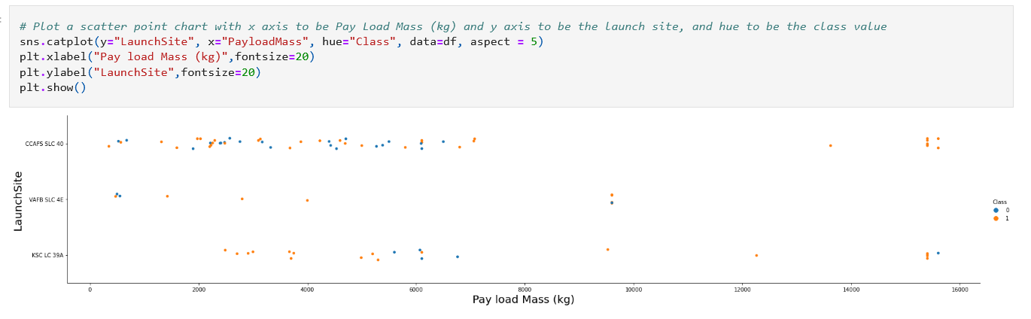
Payload vs. Launch Site
There has ben more consistent successful flights for heavier flights. Only two launchsites have carried payloads > 10000kg

Slide 21
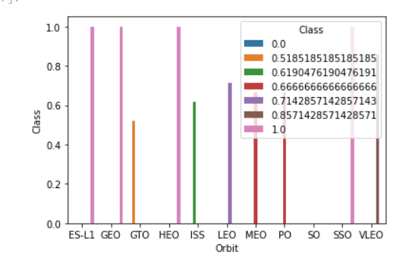
Success Rate vs. Orbit Type
From the plot, four orbits have a success rate of 1.0 (100%). This may be because they have landed fewer rockets.

Slide 22
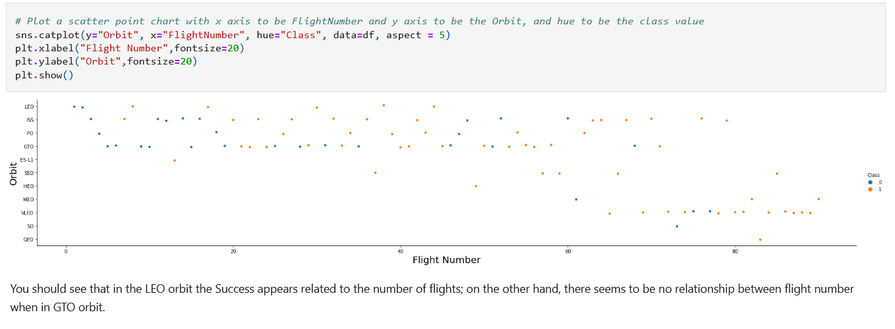
Flight Number vs. Orbit Type

Slide 23
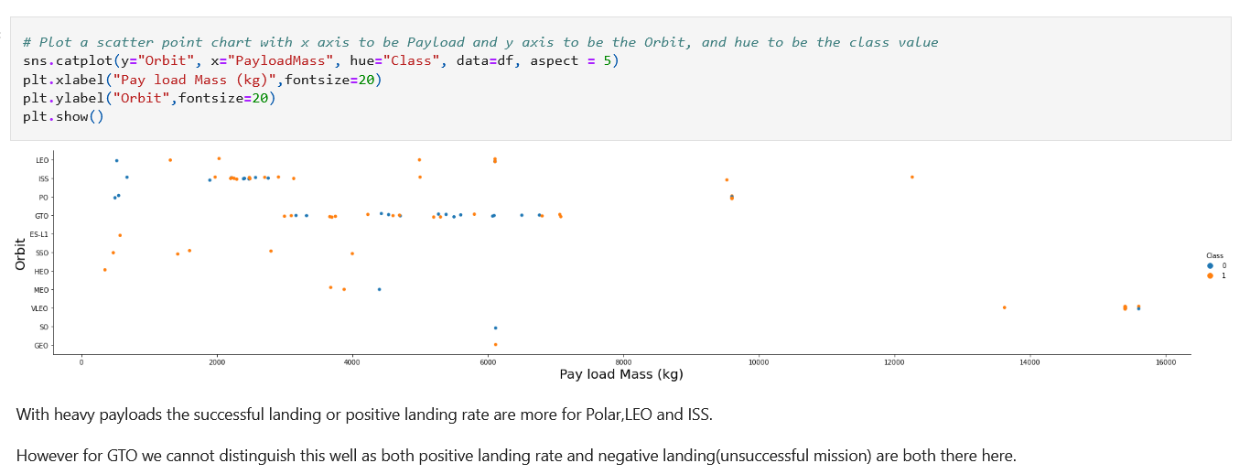
Payload vs. Orbit Type

Slide 24
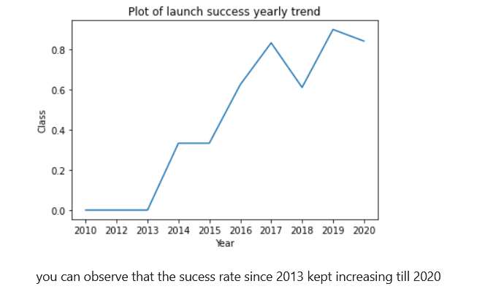
Launch Success Yearly Trend

Slide 25
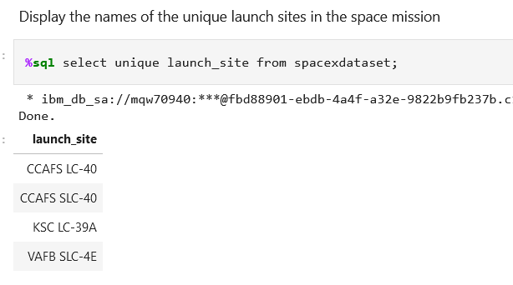
All Launch Site Names
The four launch-sites are given below

Slide 26

Launch Site Names Begin with 'CCA'
Find 5 records where launch sites begin with `CCA`
‘Like’ was used to match strings.

Slide 27
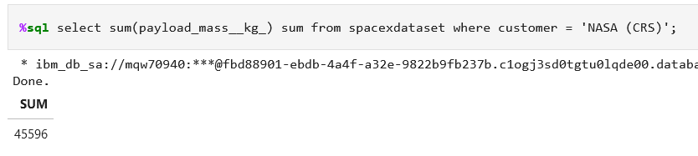
Total Payload Mass
Calculate the total payload carried by boosters from NASA
The total payload mass carried by NASA CRS is given below as 45596

Slide 28
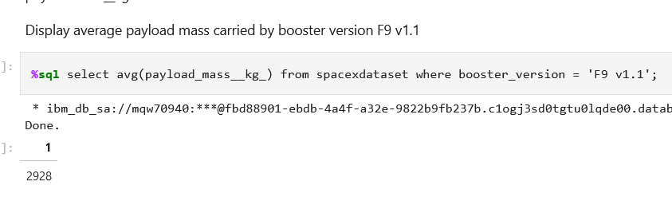
Average Payload Mass by F9 v1.1
Average payload is given below as:

Slide 29
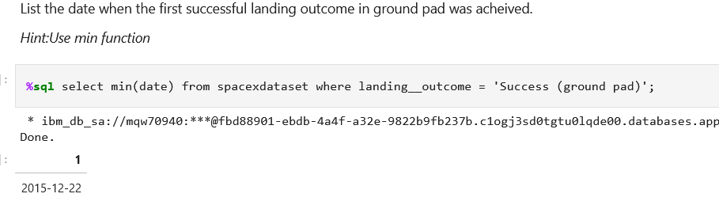
First Successful Ground Landing Date
Find the dates of the first successful landing outcome on ground pad
Min function was used to find the initial dates of first successful landing

Slide 30
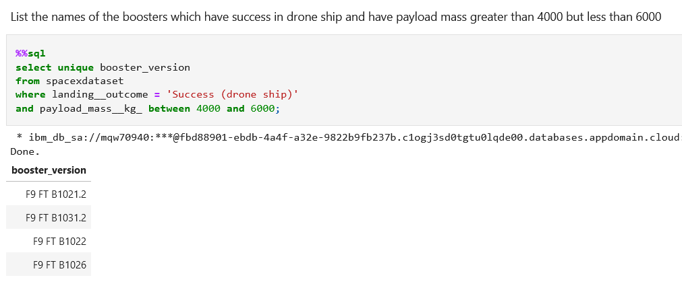
Successful Drone Ship Landing with Payload between 4000 and 6000
The query below shows the names of boosters which have successfully landed on drone ship and had payload mass greater than 4000 but less than 6000

Slide 31
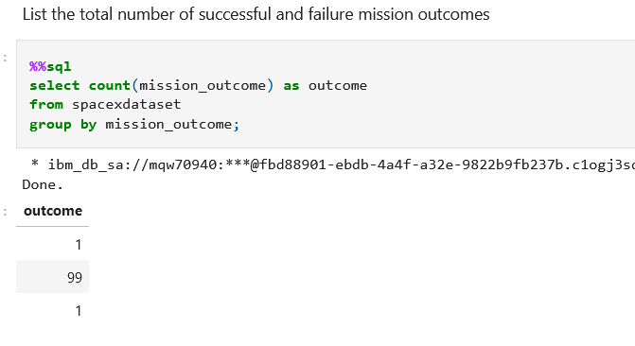
Total Number of Successful and Failure Mission Outcomes
The query below uses groupby command to compute the total number of successful and failure mission outcomes
99 successful, 1failed.

Slide 32
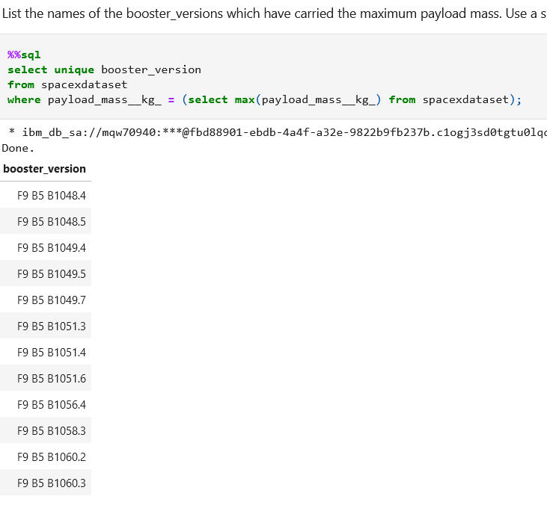
Boosters Carried Maximum Payload
The query below lists names of the booster which have carried the maximum payload mass

Slide 33
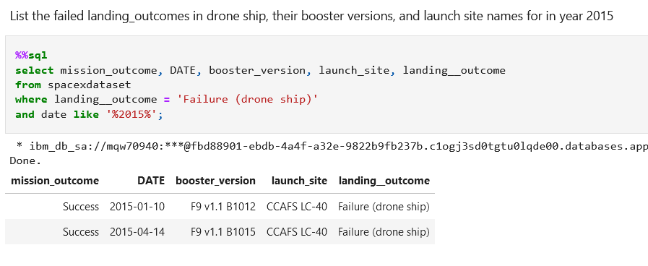
2015 Launch Records
The query below shows the failed landing outcomes in drone ship, their booster versions, and launch site names for in year 2015

Slide 34
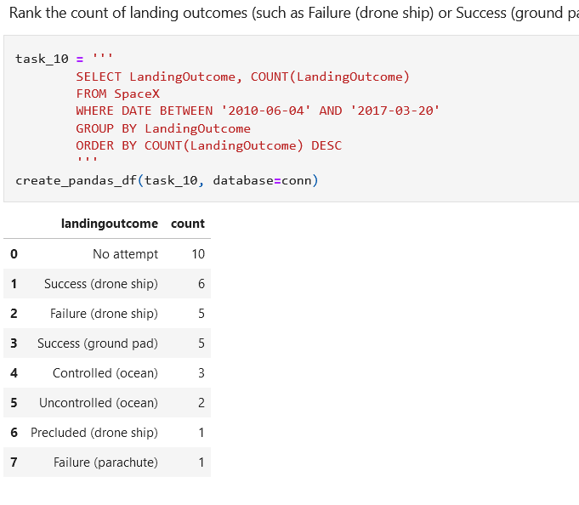
Rank Landing Outcomes Between 2010-06-04 and 2017-03-20
Ranks of the count of landing outcomes (such as Failure (drone ship) or Success (ground pad)) between the date 2010-06-04 and 2017-03-20, in descending order is shown below using the following sql code:

Slide 35

Section 3

Slide 36
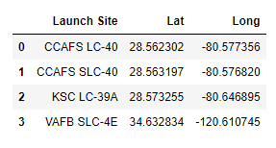
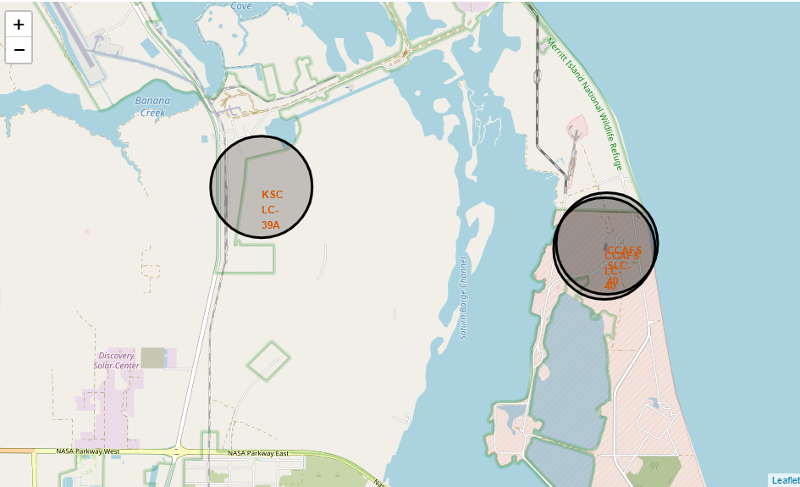
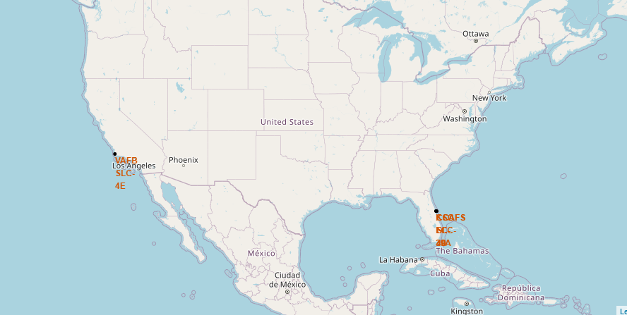
Analyzing the Existing Launch sites

Slide 37
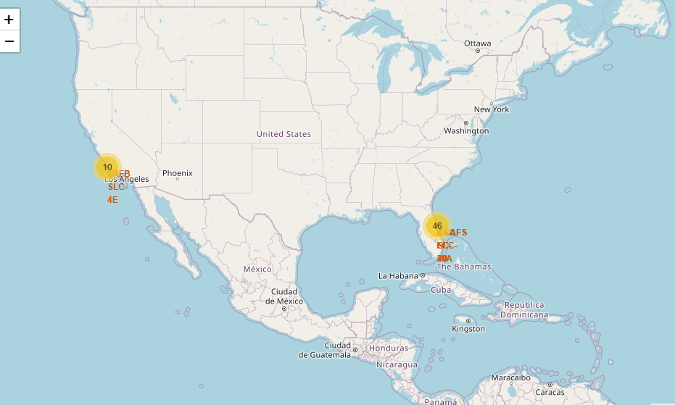
Delving into the launch sites
Launch sites are located close to large water bodies and afar from big cities
From the screenshots, we can see the number of launches on different launch sites. Only 10 launches have taken place from VAFB-SLC-4E launch site.

Slide 38
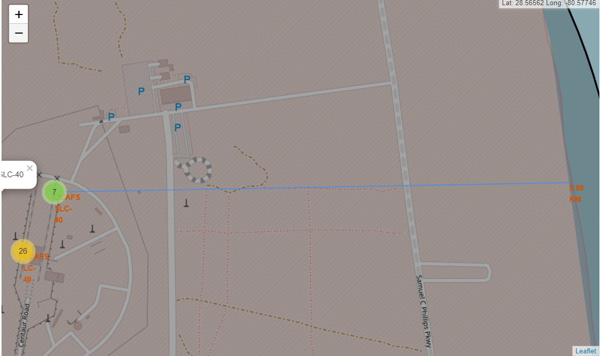
Deeper into launch sites
The launch-site shown in this screenshot is close to the shoreline less than 1km from shoreline. This Is also close to a nearby railway and highway to enable transportation of launch materials

Slide 39

Section 4

Slide 40
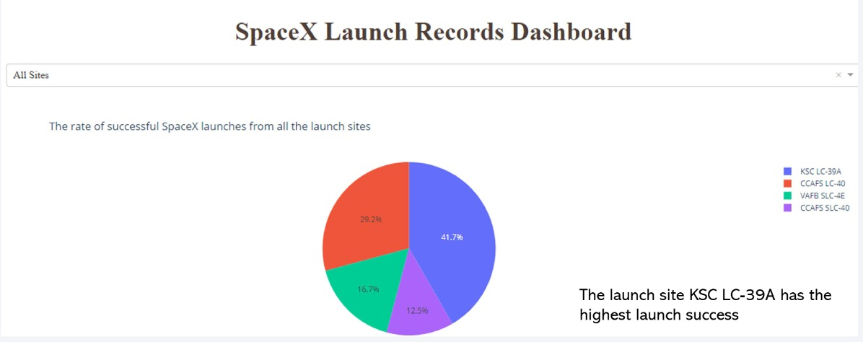
SpaceX launch Dashboard

Slide 41
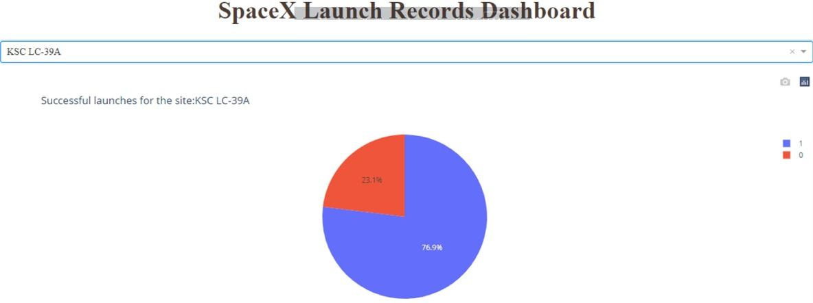
Site KSC LC-39A
This launch site has a success rate of 77% and a failure rate if about 23%
This means that about 1 in 4 launches are unsuccessful.

Slide 42
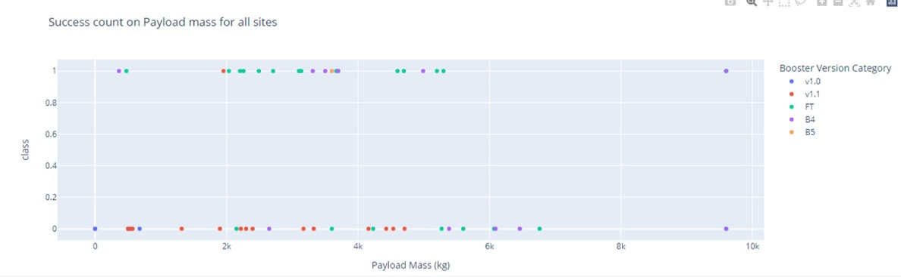
Success count versus payload mass

Slide 43

Section 5

Slide 44
Classification Accuracy
The decision tree had the highest classification accuracy on the test data.

Slide 45
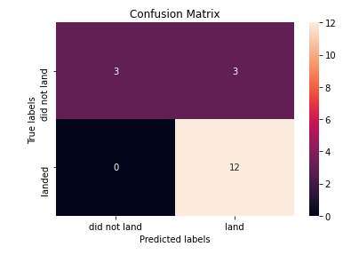
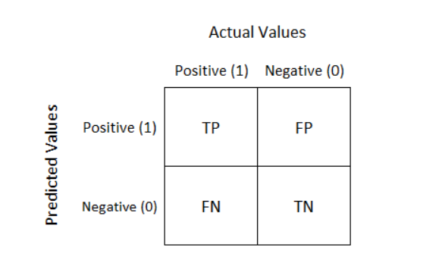
Confusion Matrix
From the Confusion matrix, we can see that we have a True Negative of 3, a True Positive of 12 correct predictions, a False positive of 0 and a False Negative of 3.
]this means that on three occasions, our decision tree model predicted that the rocket did not land when it actually landed.

Slide 46
Conclusions
The success of a rocket launch depends on different factors ranging from payload mass, target orbit, launch site, etc
Different orbits have different success rates
It is possible to predict the success or failure of a falcon 9 rocket launch
The decision tree algorithm was used to predict the success or failure of a falcon 9 rocket with 89% accuracy.

Slide 47


